Slide 1
Separation of Solids from Gas
Dr. Swambabu Varanasi

Slide 2
Application
Removal of dust particles from air (PM10, PM 2.5, etc)
Solids from gas needs to separated at the discharge point in a pneumatic conveyor
When coal burn for energy, coal/soot particles mixes with air needs to be separated
Catalyst particles in a reactant/product needs to separated
Separation of pharmaceutical powders from gas

Slide 3
Types
Gravity separator
Filter – Bag filter
Centrifugal separator – cyclone separator
Scrubbers
Electrostatic precipitator

Slide 4
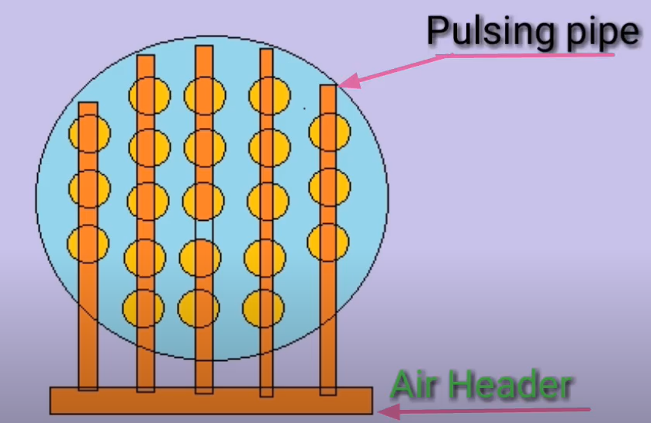
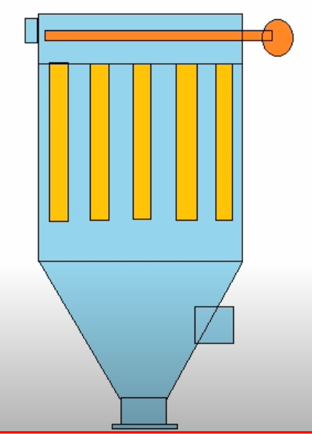
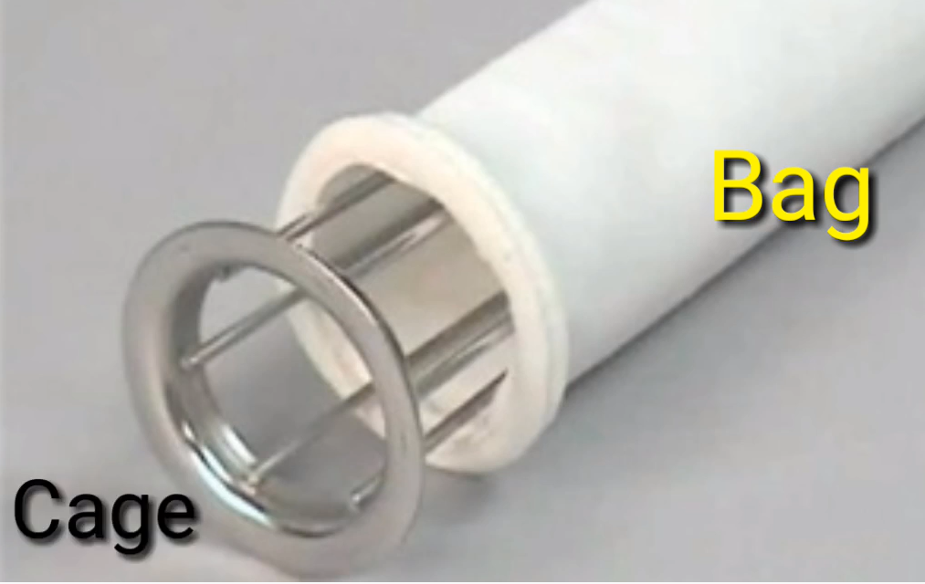
Bag Filter

Slide 5
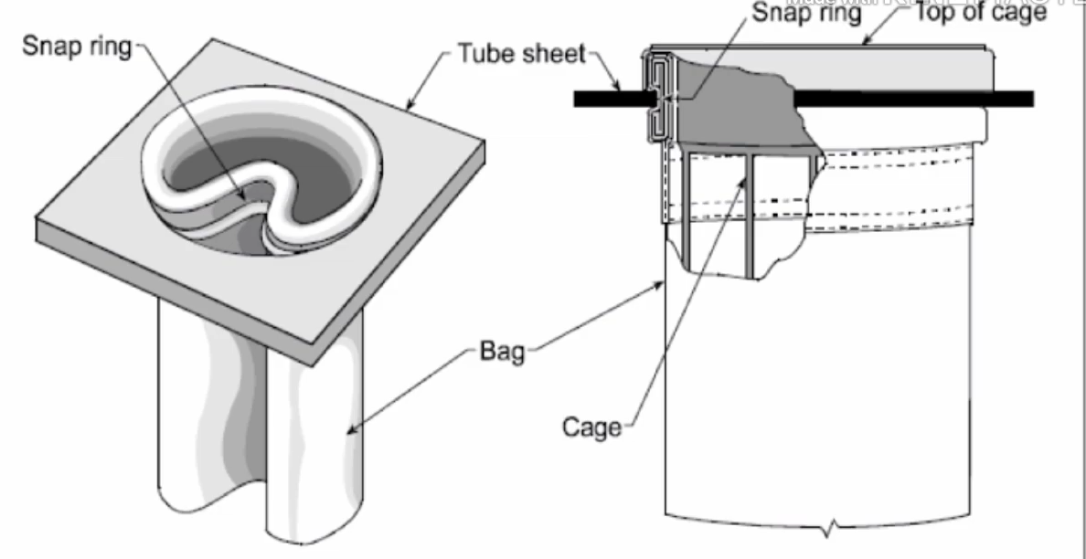
Bags
Flet media filters
Woven media filters

Slide 6
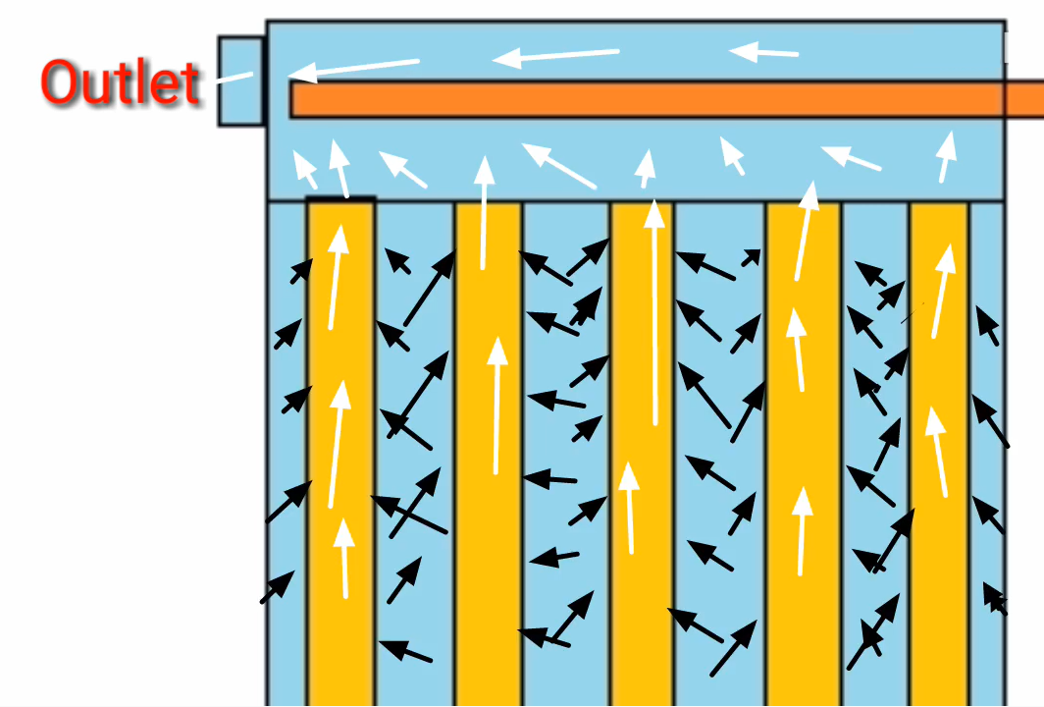
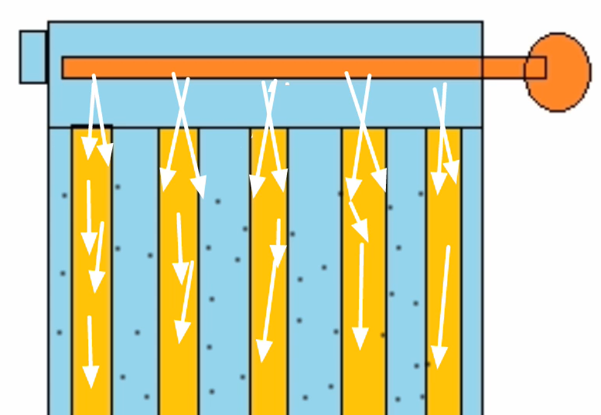
Separation Mechanism
During filtration
After filtration

Slide 7
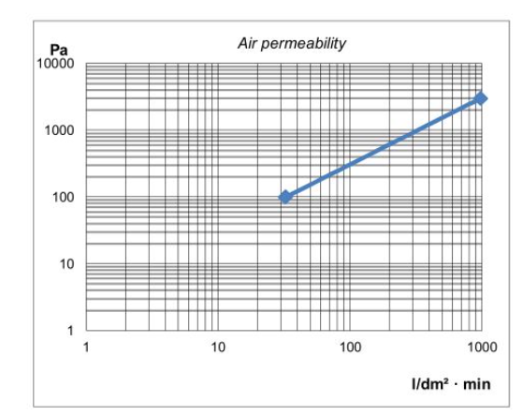
Design criteria
Filtration velocity = air/cloth ratio
Air permeability = volumetric flowrate/ area

Slide 8
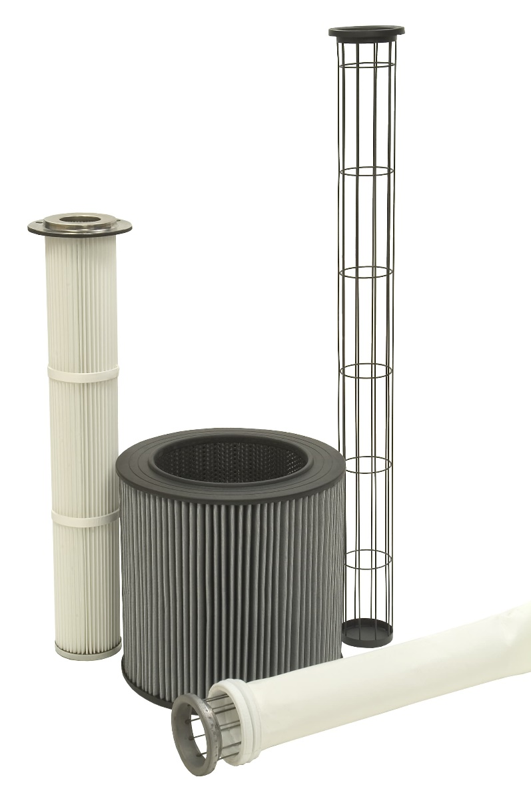
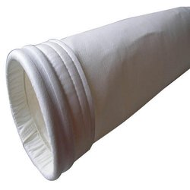
Bag filter for domestic applications

Slide 9
Cyclone Separator
Reverse flow or Tangential inlet cyclone separator
Axial flow cyclone separator

Slide 10
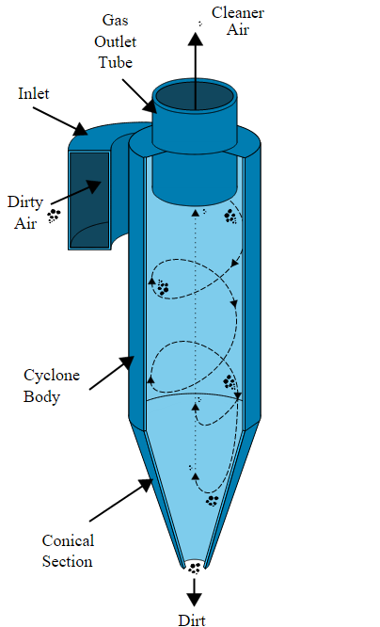
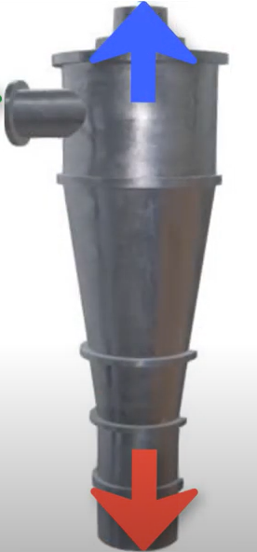
Reverse flow cyclone separator

Slide 11
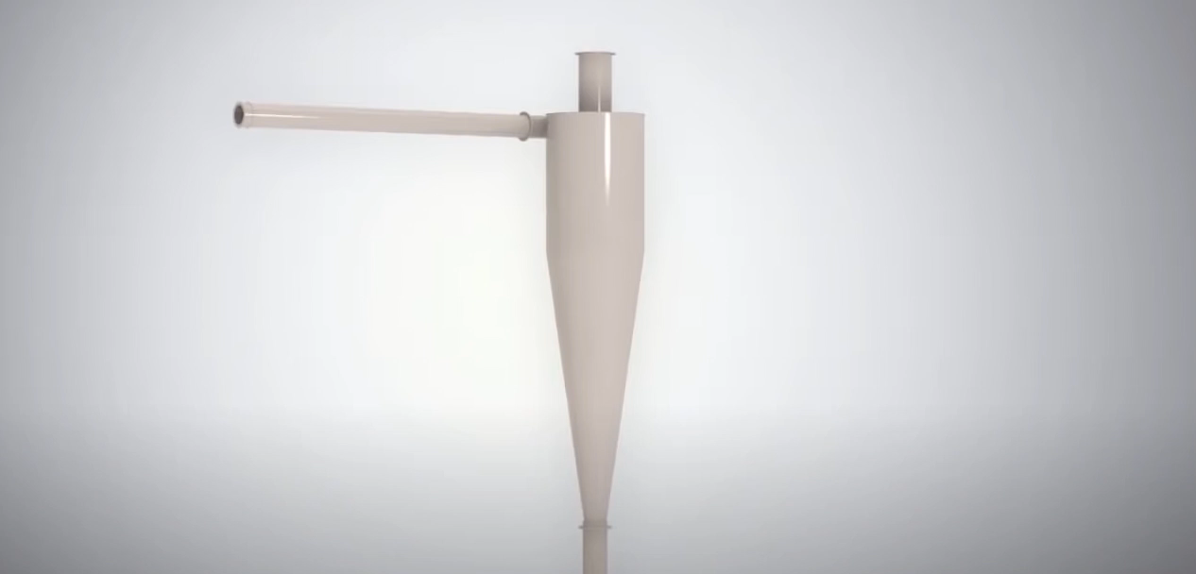
Working principle

Slide 12
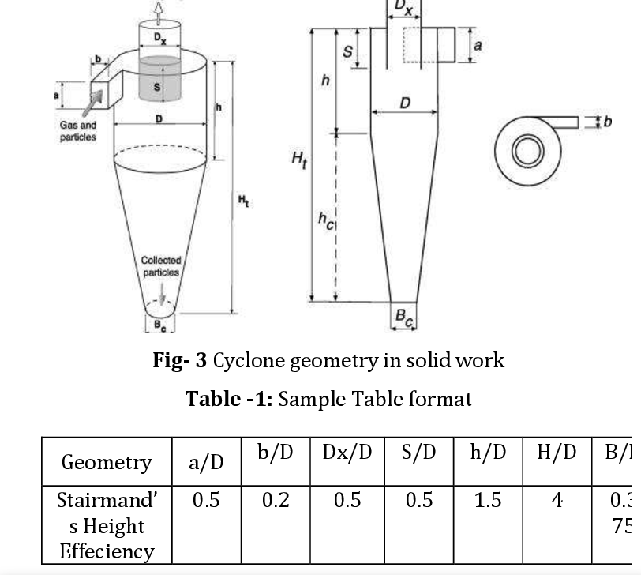
Design

Slide 15
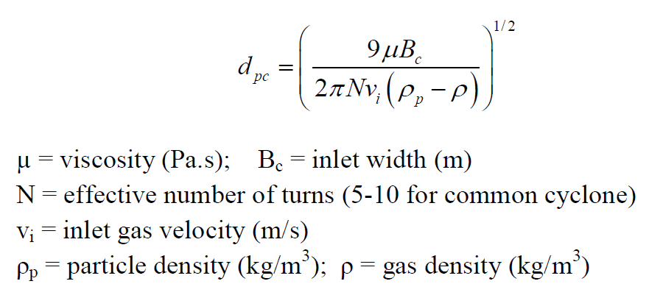
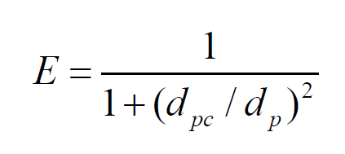
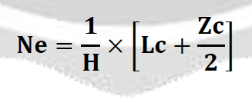
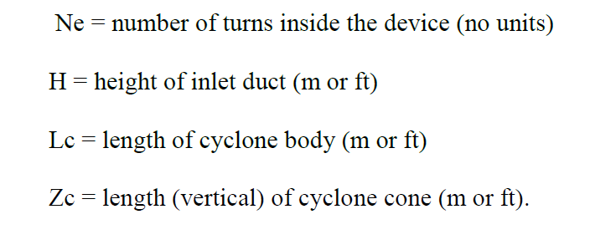
Performance parameters
Cut particle diameter
Collection efficiency
Pressure drop
Shepard and Lapels equation

Slide 16
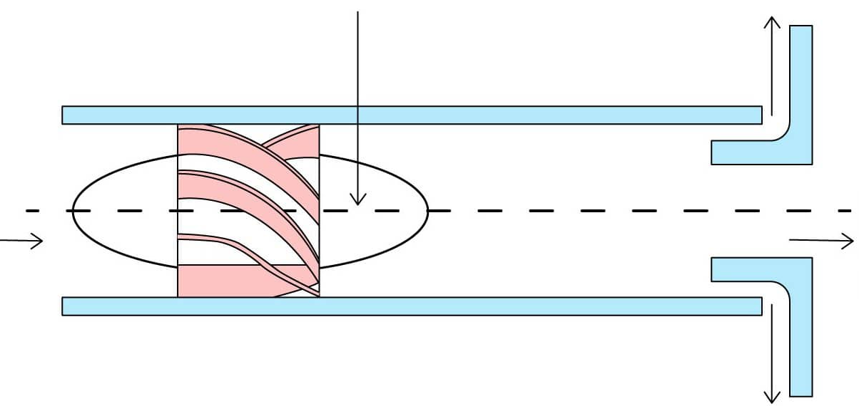
Axial flow cyclone separator

Slide 18
Electrostatic Precipitator

Slide 19
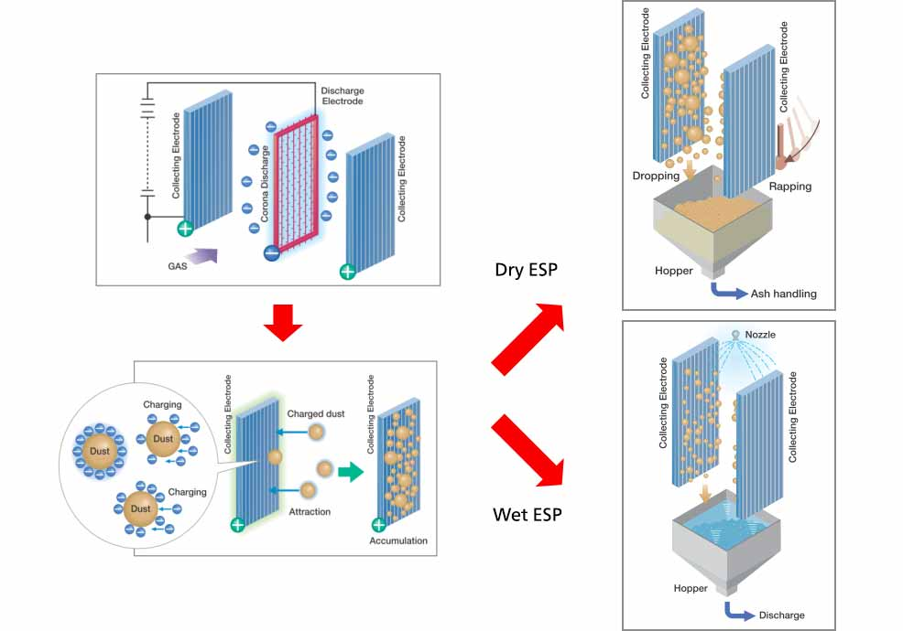
Working Principle
Gap between plates : 4 to 6’
Voltage : 40 to 60 kV (single stage) , 13 to 15 kV (Two stage)
Source: https://power.mhi.com/products/aqcs/lineup/dust-collector

Slide 20
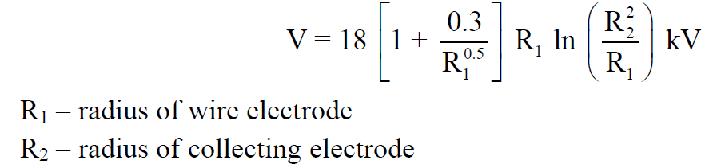
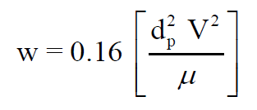
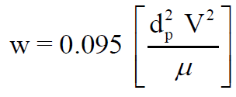
ESP Contd..
Necessary voltage :
Velocity of collection particles
conducting particles:
non-conducting particles:
Collection efficiency of particle : 1 – exp(Q_{g}/ w.A_{C})

Slide 21
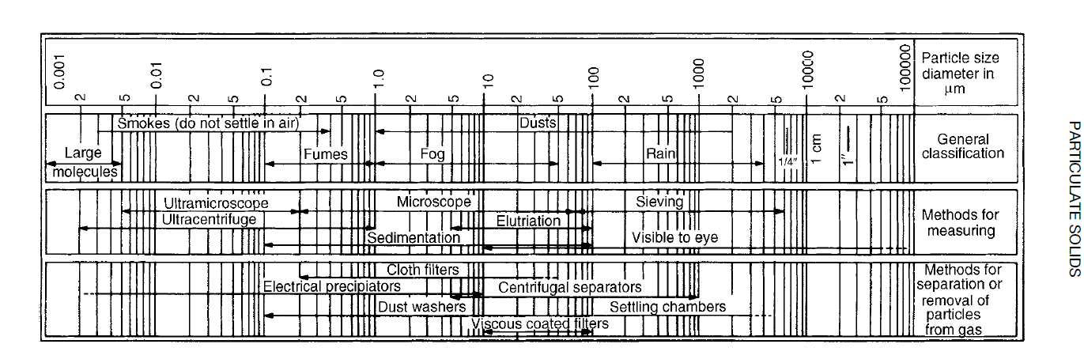

Slide 22
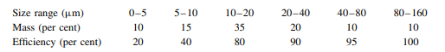
The size distribution by mass of dust carried in a gas, together with the efficiency of collection over each size range, as follows:
Calculate the overall efficiency of the collector, and the percentage by mass of the emitted dust that is smaller than 20 microns.
2. A cyclone has an inlet width of 15 cm and the shortest length of 25 cm with diameter of 0.5m, operates at five effective turns. The gas temperature is 345K and the inlet velocity is 20 m/s. determine the (a) cut-particle diameter (b) pressure drop (c) separation factor.
Data: average particle size is 10 µm, particle density 1.2 g/cc. Density and viscosity of air are 1.2 kg/m3 and 0.0745 kg/m-h.

Slide 23
3. Dust has particles with migration velocity of 0.25 m/s. For a total air flow of 65 m3 /s, what must be the number of collecting plates each having area of 50 m2 .Assume collection efficiency to be 95%.
Reading material : Coulson and Richardson’s CHEMICAL ENGINEERING, VOLUME 2

